Slide 1

Lenguaje de Programación
Unidad VI: Otros paradigmas de programación

Slide 2
Crear Base de datos: bdregisters
CREATE TABLE cities (
id INT AUTO_INCREMENT PRIMARY KEY,
name VARCHAR(255),
status BOOLEAN
);
CREATE TABLE jobsJ(
id int AUTO_INCREMENT PRIMARY KEY,
name varchar(255),
status boolean
);

Slide 3

Crear Base de datos
CREATE TABLE employees (
id INT AUTO_INCREMENT PRIMARY KEY,
nombre VARCHAR(255),
ciudad_id INT,
job_id INT,
salary DOUBLE,
status BOOLEAN DEFAULT 1,
FOREIGN KEY (ciudad_id) REFERENCES cities(id),
FOREIGN KEY (job_id) REFERENCES jobsj(id)
);

Slide 4

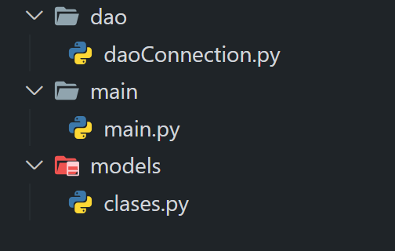
Abrir carpeta
Cree una carpeta llamada ConexionBD
Dentro de esta carpeta cree las siguientes carpetas

Slide 5

Clase Connection
import mysql.connector
class Connection:
def __init__(self, host, user, password, database):
self.host = host
self.user = user
self.password = password
self.database = database
self.cnx = None
self.connect()
def connect(self):
self.cnx = mysql.connector.connect(user=self.user, password=self.password, host=self.host, database=self.database)

Slide 6
Clase Connection
def close(self):
self.cnx.close()
def execute_query(self, query, params):
cursor = self.cnx.cursor()
cursor.execute(query, params)
self.cnx.commit()
cursor.close()
return cursor
def execute_read_query(self, query, params):
cursor = self.cnx.cursor()
cursor.execute(query, params)
result = cursor.fetchall()
cursor.close()
return result

Slide 7
Clase DaoCity
class DaoCity:
def __init__(self, connection):
self.connection = connection
def get_all(self):
query = 'SELECT * FROM cities'
return self.connection.execute_read_query(query, ())
def get_by_id(self, id):
query = 'SELECT * FROM cities WHERE id = %s'
return self.connection.execute_read_query(query, (id,))

Slide 8
Clase DaoCity
def insert(self, city):
query = 'INSERT INTO cities (name, status) VALUES (%s, %s)'
return self.connection.execute_query(query, (city.name, city.status))
def update(self, city):
query = 'UPDATE cities SET name = %s, status = %s WHERE id = %s'
return self.connection.execute_query(query, (city.name, city.status, city.id))
def delete(self, id):
query = 'DELETE FROM cities WHERE id = %s'
return self.connection.execute_query(query, (id,))

Slide 9

Clase City
class City:
def __init__(self, name, status):
self.name = name
self.status = status
def __str__(self):
return self.name
***Crear el resto de clases, relacionadas con las tablas creadas en la base de datos***

Slide 10

Implementación
import os
import dao.daoConnection as dao
import models.clases as clases
os.system('cls')
#conectar bd
conex = dao.Connection("localhost", "root", "", "dbregisters")
conex.connect()
#instanciar dao
daoCity = dao.DaoCity(conex)

Slide 11

Instanciar
#instanciar modelo
city1 = models.clases.City(0, "Managua", 1)
city2 = models.clases.City(0, "León", 1)
city3 = models.clases.City(0, "Granada", 1)
city4 = models.clases.City(0, "Masaya", 1)
city5 = models.clases.City(0, "Estelí", 1)
city6 = models.clases.City(0, "Jinotepe", 1)

Slide 12

Insertar registros
#insertar
daoCity.insert(city1)
daoCity.insert(city2)
daoCity.insert(city3)
daoCity.insert(city4)
daoCity.insert(city5)
daoCity.insert(city6)

Slide 13

Mostrar registros
#consultar
cities = daoCity.get_all()
for city in cities:
print(city)

